Slide 1
Enterprise Integration
Focus: Backend
Notes:
KEY
Provide participants with administrative information
HOW
Welcome participants to the course
Briefly, introduce the course
Briefly, introduce yourself as the instructor of the course
Discuss breaks and lunch
Emphasize the importance of sticking to the schedule - starting on time so that the class can end on time
Explain that attendance during all sessions is mandatory to receive course proof of attendance
TIME
5 min

Slide 2
Training Overview
Group Workshop
Back-end
Front-end
Enterprise
Integration
Content
Services
Advanced
Security
Overview
Widget Development
Template
Development
Targeting
Publishing
Portal Client
ICE
Foundation
Portal Essentials
Portal Technologies
Portal Tools
Portal APIs
Notes:
KEY
Introduce the CXP Backend training and this module
HOW
Explain to participants that this is the start of the CXP Backend training
Give an overview of each CXP training (Foundation + FE + BE)
Explain that this is also the beginning of the Enterprise Integration module
TIME
2 min

Slide 3
Objectives
Enterprise integration
Introduction to Apache Camel
Apache Camel in CXP
Exercises
Notes:
KEY
Describe the module objectives
HOW
Tell participants that these are the primary targets for this module
Discuss each of the goals listed on the visual
TIME
1 min

Slide 4
Enterprise Integration
What is it and why do we need it

Slide 5
Enterprise Integration
Challenges
Data integration
Web Services
REST
Messaging
Proprietary API
HTML integration
Proxy
Screen scraping
Caching data
Notes:
KEY
Describe typical Enterprise Integration challenges
HOW
Discuss each challenge listed on the visual. Be prepared to provide examples.
Screen Scraping - The action of using a computer program to copy data from a website. Process of collecting screen display data from one application and translating it so that another application can display it. This is normally done to capture data from a legacy application in order to display it using a more modern user interface
TIME
1 min

Slide 6
Enterprise Integration
Challenges
Filter and transform data
Convert POJO’s to JSON
Combine data sources
Renditions
PDF
Excel
HTML
Route messages
Send messages to different targets
Based on payloads
Or other rules
Notes:
KEY
Describe typical EI challenges (cont.)
HOW
Discuss each challenge listed on the visual. Be prepared to provide examples.
TIME
1 min

Slide 7
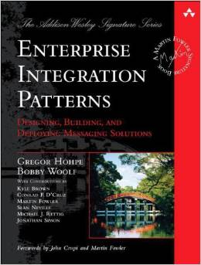
Enterprise Integration Patterns
Patterns
Provide guidance
Common language
Outlines solutions to common challenges
65+ patterns
Available platforms
Spring Integration
Mule ESB
Apache Camel
Commercial offerings
Notes:
KEY
Enterprise Integration Patterns
HOW
Tell participants that EIP are commonly used by organizations to solve integration problems.
TIME
1 min

Slide 8
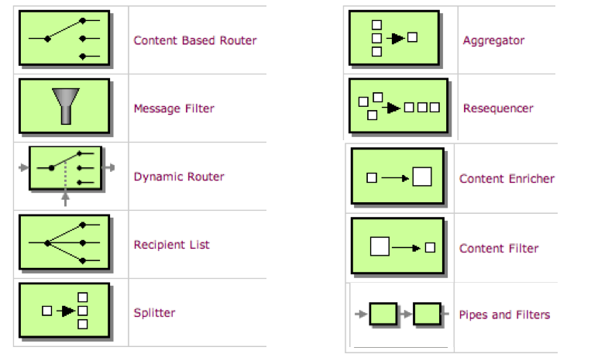
Enterprise Integration Patterns
http://camel.apache.org/eip
Notes:
KEY
Enterprise Integration Patterns (cont.)
HOW
Briefly describe the list of typical patterns used in companies.
TIME
3 min

Slide 9

Introduction to Apache Camel
Heavy payloads with few resources

Slide 10

Apache Camel
Lightweight integration library
Kind of an embedded ESB
Enterprise Integration Patterns
Domain Specific Language
Routing and Mediation
Components
Built in Transformers
Active Community
Easy to extend
Concise
Application
Messaging
Exchange
Language
Notes:
KEY
Apache Camel Introduction
ESB - is implementing a communication system between mutually interacting software applications in a service-oriented architecture (SOA).
HOW
Introduce Camel.
TIME
3 min

Slide 11
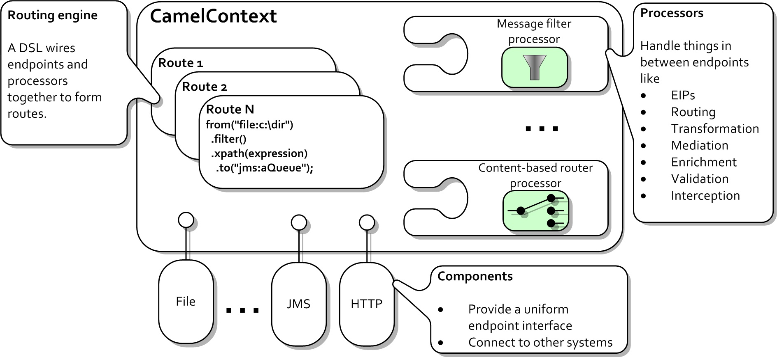
Apache Camel
Quick Overview
Notes:
KEY
Apache Camel (cont.)
Routing Engine – A DSL wires endpoints and processors together to form routes.
Components – Provides a uniform endpoint interface and connect ot other systems.
Processors – Handles things in between endpoints like, EIPs, Routing, Transformation, Mediation, Enrichment, Validation, Interception.
HOW
Discuss terms on slide and then zoom in on the terminology used in Camel
TIME
3 min

Slide 12
Apache Camel
Endpoint
Describes a service from which information can be retrieved or sent to
Examples of endpoint
JMS queue
Web Service
FTP Server
Twitter
Plain Old Java Object
Endpoints can behave in 2 ways
Consumer
Producer
Notes:
KEY
Endpoint
HOW
Introduce the concept of endpoint
TIME
3 min

Slide 13
Apache Camel
Component
AKA: EndpointFactory
Component creates Endpoints based on configuration
Identified by using a URI format
scheme:localpart[?options]
Creates consumer and producer endpoints
<from uri=”file://inbox?move=.done&delay=1000”/>
<to uri=”jms:queue:order?priority=5”/>
Lots of Camel Components available
Full list at: http://camel.apache.org/components.html
Notes:
KEY
Apache Camel Components
HOW
Introduce the concept of Component in Apache Camel
Tell participants that a component is nothing more than an ”Endpoint Factory”
Explain in details the URI syntax
From – Consumer
To - Producer
TIME
3 min

Slide 14
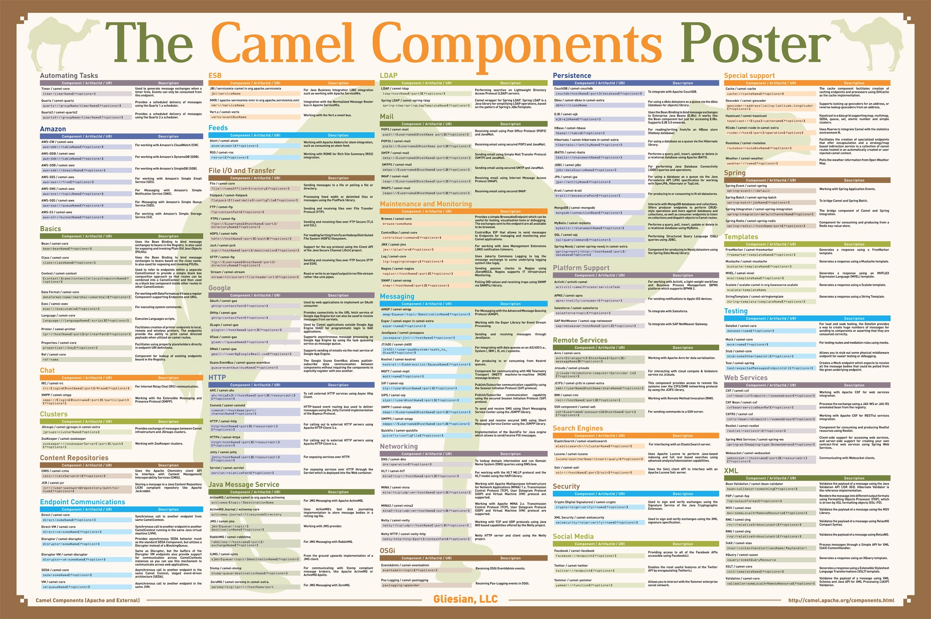
Apache Camel
Notes:
KEY
Apache Camel Components
HOW
Just mention that the framework has a variety of out-of-the-box components available.
TIME
1 min

Slide 15
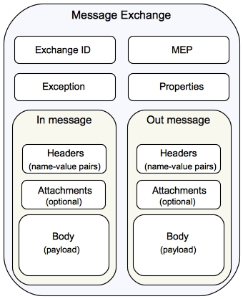
Apache Camel
Message and Exchange
Messages wrap requests, responses, and exceptions and contain
Headers
Payload
Attachments
Exchange
Contains
Unique ID
Incoming and outgoing message
Exception
Properties
Notes:
KEY
Message and Exchange objects
HOW
Introduce the exchange object, message and how it works depending on the configured MEP (message exchange pattern)
TIME
5 min

Slide 16
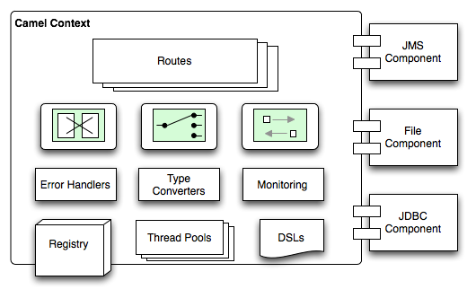
Apache Camel
Camel Context
Typically one per application
Provides the runtime for the Camel routes
Serves as a registry for endpoints and components
Camel Contexts contains Routes and Route Contexts
Routes can be grouped together in Route Contexts
Notes:
KEY
Camel Context
HOW
Explain that Camel Context is made of route context and routes.
TIME
2 min

Slide 17
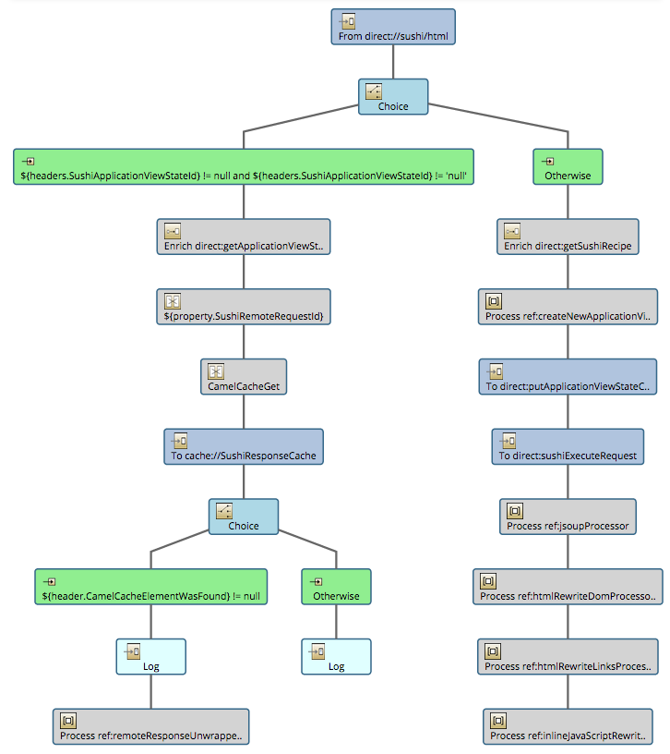
Apache Camel
Routes
Step-by-step movement of a message through an exchange.
Configured by DSL
Spring XML and Java are examples of DSL
Notes:
KEY
Routes
HOW
Explain that routes could be represented as trees and the main activities are routing and transformations.
TIME
2 min

Slide 18
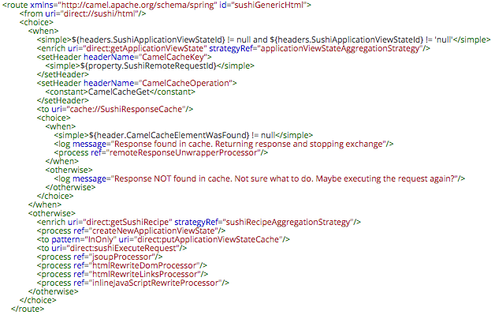
Apache Camel
Spring XML
Uses Camel XSD Schema
Verbose
Property Placeholder Support
Notes:
KEY
Routes (cont.)
HOW
Show an example of route written using the Spring XML DSL
TIME
1 min

Slide 19
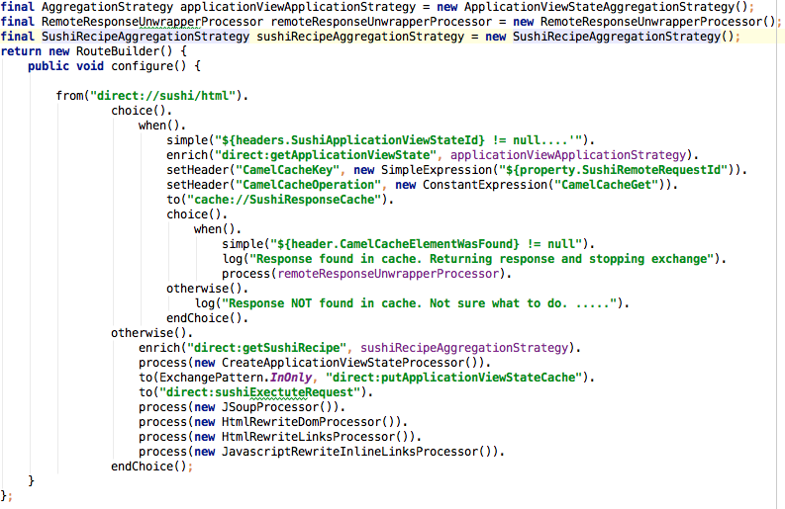
Apache Camel
Java DSL
Syntactic sugar
Difficult to format
Autocomplete awareness in IDE
Notes:
KEY
Routes (cont.)
HOW
Show an example of route written using the Java DSL
TIME
1 min

Slide 20
Apache Camel
List of available DSL
DSL | Description
Java | A Java based DSL using the fluent builder style
Spring | A XML based DSL in Spring XML files
Blueprint | A XML based DSL in OSGi Blueprint XML files
REST | A DSL to define REST services using a REST style in either Java or XML
Groovy | A Groovy based DSL using Groovy programming language
Scala | A Scala based DSL using Scala programming language
Annotation | Use annotations in Java beans
Kotlin | A Camel DSL that allows using Kool Expressions
Notes:
KEY
Available DSL
HOW
Show the list of available DSLs
TIME
1 min

Slide 21
Apache Camel
Processors
MyProcessor.java
public class MyProcessor
implements Processor {
public void process(Exchange ex) {
// do something …
}
}
Route Snippet (using Spring XML DSL)
<from uri=”jms:queue:orders” />
<process ref=”myProcessor”/>
<to uri=”jms:queue:stockorders”/>
The Processor interface is used to implement consumers of message exchanges or to implement a Message Translator
Can modify the incoming message or the outgoing message
Possibilities are endless
Notes:
KEY
Processors
HOW
Tell participants that processors can be inserted into routes to manipulate message exchanges
TIME
1 min

Slide 22
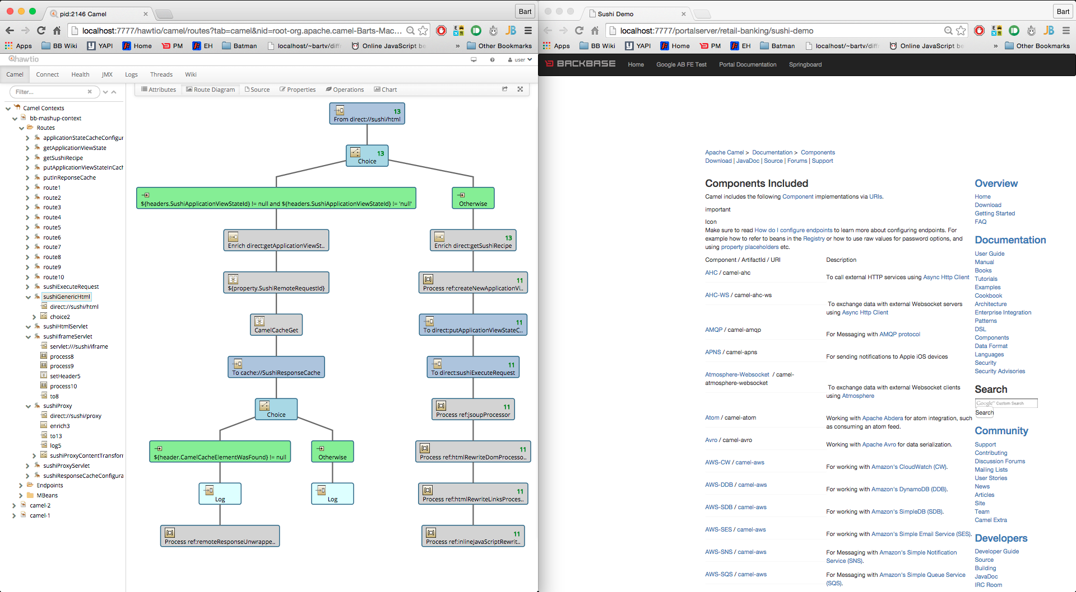

Apache Camel Demo
Notes:
KEY
Demo
HOW
The objective of this demo is present a typical route of Apache Camel. Keep in mind that this is not an Apache Camel course. Thus, limit the demo to show the following building blocks (route, endpoints, content-based routers, components).
Access the hawtio console of your portal server (http://localhost:9999/hawtio)
Show the graphical representation of one of your routes (e.g.training-server/training.server.player.highscore.update)
Show each component (e.g. endpoint, transformers)
Show debugging capabilities of hawtio
TIME
1 min

Slide 23
Apache Camel In CXP
How to work with Apache Camel and CXP

Slide 24
Apache Camel In CXP
Integrated in CXP
Apache Camel 2.12.4
To remain compatible with JBoss Fuse for commercial support
Camel Context defined by Launchpad
Defines default RESTlet $(contextRoot)/services/rest/*
RestletRouterProcessor forwards requests to RESTlet routes
Route Contexts are loaded automatically from spring context files
classpath*:META-INF/spring/backbase-integration-service.xml Route Context IDs must be prefixed with
com.backbase.portal.integration.service
Embedded or stand alone
Notes:
KEY
Camel in CXP
HOW
Describe how Apache Camel fits into the CXP environment (supported versions, naming conventions).
TIME
2 min

Slide 25
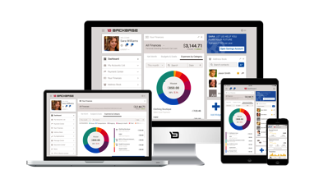
Apache Camel In CXP
Backbase Launchpad
WOA
Widget
Widget
Widget
Widget
Widget
Widget
ASYNCHRONOUS
RESTLET
RESTLET
Integration Services
Content Services
Personalization Services
Security Services
SOA
ROUTE
ROUTE
Existing
Systems
Message Queue
Notes:
KEY
Camel in CXP
HOW
Explain that Widgets communicate with external systems using the Integration Services layer.
Step 1 – Widget Communicate to Integration Services using Restlet route and then Integration Services using Route.
TIME
1 min

Slide 26

Apache Camel In CXP
WOA
Widget
Widget
Widget
ASYNCHRONOUS
RESTLET
RESTLET
Integration Services
HTML Integration:
WWW
(X)HTML
Application
Data Integration:
Web Services
Web Interfaces
SOA
ROUTE
ROUTE
Existing Systems
Message Queue
Notes:
KEY
Camel in CXP
HOW
Explain the set of components that belong to the Integration Services layer
TIME
1 min

Slide 27
Apache Camel In CXP
WOA
Widget
Widget
Widget
ASYNCHRONOUS
Asynchronous:
Web sockets
Long polling
Piggy-backing
RESTLET
RESTLET
Integration Services
HTML Integration:
WWW
(X)HTML
Application
Data Integration:
Web Services
Web Interfaces
Clipping
Connectors
Transforming
SOA
Templating
Filter
Caching
ROUTE
ROUTE
BackbaseMQ
Existing MQ
Existing Systems
Message Queue
Notes:
KEY
Camel in CXP
HOW
Explain the set of components that belong to the Integration Services layer
TIME
1 min

Slide 28
Apache Camel In CXP
Implementation details
Camel Context is defined in backbase-integration.xml
backbase-integration.xml is added to contextConfigurationLocation array in web.xml <context-param> <param-name>contextConfigLocation</param-name> <param-value><![CDATA[ classpath:/META-INF/spring/backbase-portal-application-config.xml classpath:/META-INF/spring/backbase-portal-integration-config.xml classpath:/META-INF/spring/backbase-portal-presentation-security.xml classpath:/META-INF/spring/backbase-portal-presentation-ssr.xml classpath:/META-INF/spring/backbase-portal-business-security.xml classpath:backbase-ptc.xml classpath:/META-INF/spring/backbase-integration.xml ]]></param-value> </context-param>
Integration Servlet in web.xml defines main entry point <servlet> <servlet-name>Integration Servlet</servlet-name> <servlet-class>com.backbase.portal.integration.core.servlet.IntegrationServlet</servlet-class> <load-on-startup>1</load-on-startup> </servlet> <servlet-mapping> <servlet-name>Integration Servlet</servlet-name> <url-pattern>/services/*</url-pattern> </servlet-mapping>
Descriptor with CXP standard routes
Notes:
KEY
Webapp/portalserver/src/main/webapp/web-inf/web.xml
HOW
Explain that this is the web.xml file of the webapps/portalserver. A set of configuration files is specified here (e.g. for presentation, security, and integration). The file backbase-integration.xml defines the standard routes. Tell participants that it can be found in the file webapps/portalserver/target/portalserver/WEB-INF/lib integration-core-5.6.x.x.jar!META-INF/spring
TIME
1 min

Slide 29
REST Entry Point
Default REST entry point
<route> <from uri="servlet:///defaultRESTEntryPoint…”/> <setHeader headerName="BackbaseServiceDestinationURL"> <simple>${header.CamelHttpServletRequest.getAttribute('BackbaseServiceDestinationURL')}</simple> </setHeader> <doTry> <process ref="userContextPopulatingProcessor" /> <to uri="direct:integration.restDestinationRoute" /> <doCatch> <exception>java.lang.Exception</exception> <setHeader headerName="CamelHttpResponseCode"> <constant>500</constant> </setHeader> <setBody> <simple> {"errors" : [{"code" : 500, "eventId" : "${exchangeId}", "message" : "Unexpected server error occurred"}]} </simple> </setBody> </doCatch> <doFinally> <setHeader headerName="Content-Type"> <simple>application/json; charset=UTF-8</simple> </setHeader> </doFinally> </doTry> </route>
Notes:
KEY
REST entry point
HOW
Tell participants that this is the default REST entry point. Use the animation to present each important element.
TIME
3 min

Slide 30
REST Entry Point
Default REST entry point
Valid for URIs starting with the pattern /services/rest
E.g.: http://acme.com/portalserver/services/rest/accounts/{accNumber}/details
<route> <from uri="servlet:///defaultRESTEntryPoint…”/> <setHeader headerName="BackbaseServiceDestinationURL"> <simple>${header.CamelHttpServletRequest.getAttribute('BackbaseServiceDestinationURL')}</simple> </setHeader> <doTry> <process ref="userContextPopulatingProcessor" /> <to uri="direct:integration.restDestinationRoute" /> <doCatch> <exception>java.lang.Exception</exception> <setHeader headerName="CamelHttpResponseCode"> <constant>500</constant> </setHeader> <setBody> <simple> {"errors" : [{"code" : 500, "eventId" : "${exchangeId}", "message" : "Unexpected server error occurred"}]} </simple> </setBody> </doCatch> <doFinally> <setHeader headerName="Content-Type"> <simple>application/json; charset=UTF-8</simple> </setHeader> </doFinally> </doTry> </route>
Notes:
KEY
REST entry point
HOW
Tell participants that this is the default REST entry point. Use the animation to present each important element.
TIME
3 min

Slide 31
REST Entry Point
Default REST entry point
<route> <from uri="servlet:///defaultRESTEntryPoint…”/> <setHeader headerName="BackbaseServiceDestinationURL"> <simple>${header.CamelHttpServletRequest.getAttribute('BackbaseServiceDestinationURL')}</simple> </setHeader> <doTry> <process ref="userContextPopulatingProcessor" /> <to uri="direct:integration.restDestinationRoute" /> <doCatch> <exception>java.lang.Exception</exception> <setHeader headerName="CamelHttpResponseCode"> <constant>500</constant> </setHeader> <setBody> <simple> {"errors" : [{"code" : 500, "eventId" : "${exchangeId}", "message" : "Unexpected server error occurred"}]} </simple> </setBody> </doCatch> <doFinally> <setHeader headerName="Content-Type"> <simple>application/json; charset=UTF-8</simple> </setHeader> </doFinally> </doTry> </route>
Calling a processor that provides session information
E.g. user id, session id, user agent.
Notes:
KEY
REST entry point
HOW
Tell participants that this is the default REST entry point. Use the animation to present each important element.
TIME
3 min

Slide 32
REST Entry Point
Default REST entry point
<route> <from uri="servlet:///defaultRESTEntryPoint…”/> <setHeader headerName="BackbaseServiceDestinationURL"> <simple>${header.CamelHttpServletRequest.getAttribute('BackbaseServiceDestinationURL')}</simple> </setHeader> <doTry> <process ref="userContextPopulatingProcessor" /> <to uri="direct:integration.restDestinationRoute" /> <doCatch> <exception>java.lang.Exception</exception> <setHeader headerName="CamelHttpResponseCode"> <constant>500</constant> </setHeader> <setBody> <simple> {"errors" : [{"code" : 500, "eventId" : "${exchangeId}", "message" : "Unexpected server error occurred"}]} </simple> </setBody> </doCatch> <doFinally> <setHeader headerName="Content-Type"> <simple>application/json; charset=UTF-8</simple> </setHeader> </doFinally> </doTry> </route>
Calling your route
E.g. com.backbase.route.accounts.account-details-route
Notes:
KEY
REST entry point
HOW
Tell participants that this is the default REST entry point. Use the animation to present each important element.
TIME
3 min

Slide 33
REST Entry Point
Default REST entry point
<route> <from uri="servlet:///defaultRESTEntryPoint…”/> <setHeader headerName="BackbaseServiceDestinationURL"> <simple>${header.CamelHttpServletRequest.getAttribute('BackbaseServiceDestinationURL')}</simple> </setHeader> <doTry> <process ref="userContextPopulatingProcessor" /> <to uri="direct:integration.restDestinationRoute" /> <doCatch> <exception>java.lang.Exception</exception> <setHeader headerName="CamelHttpResponseCode"> <constant>500</constant> </setHeader> <setBody> <simple> {"errors" : [{"code" : 500, "eventId" : "${exchangeId}", "message" : "Unexpected server error occurred"}]} </simple> </setBody> </doCatch> <doFinally> <setHeader headerName="Content-Type"> <simple>application/json; charset=UTF-8</simple> </setHeader> </doFinally> </doTry> </route>
Safety net
Catch unhandled exceptions during the routing execution.
It will always return a HTTP 500 to the caller with additional information.
E.g. Your route generated a ArrayIndexOutOfBoundsException
Notes:
KEY
REST entry point
HOW
Tell participants that this is the default REST entry point. Use the animation to present each important element.
TIME
3 min

Slide 34
REST Entry Point
Default REST entry point
<route> <from uri="servlet:///defaultRESTEntryPoint…”/> <setHeader headerName="BackbaseServiceDestinationURL"> <simple>${header.CamelHttpServletRequest.getAttribute('BackbaseServiceDestinationURL')}</simple> </setHeader> <doTry> <process ref="userContextPopulatingProcessor" /> <to uri="direct:integration.restDestinationRoute" /> <doCatch> <exception>java.lang.Exception</exception> <setHeader headerName="CamelHttpResponseCode"> <constant>500</constant> </setHeader> <setBody> <simple> {"errors" : [{"code" : 500, "eventId" : "${exchangeId}", "message" : "Unexpected server error occurred"}]} </simple> </setBody> </doCatch> <doFinally> <setHeader headerName="Content-Type"> <simple>application/json; charset=UTF-8</simple> </setHeader> </doFinally> </doTry> </route>
Content-Type
REST content types are always JSON
Notes:
KEY
REST entry point
HOW
Tell participants that this is the default REST entry point. Use the animation to present each important element.
TIME
3 min

Slide 35
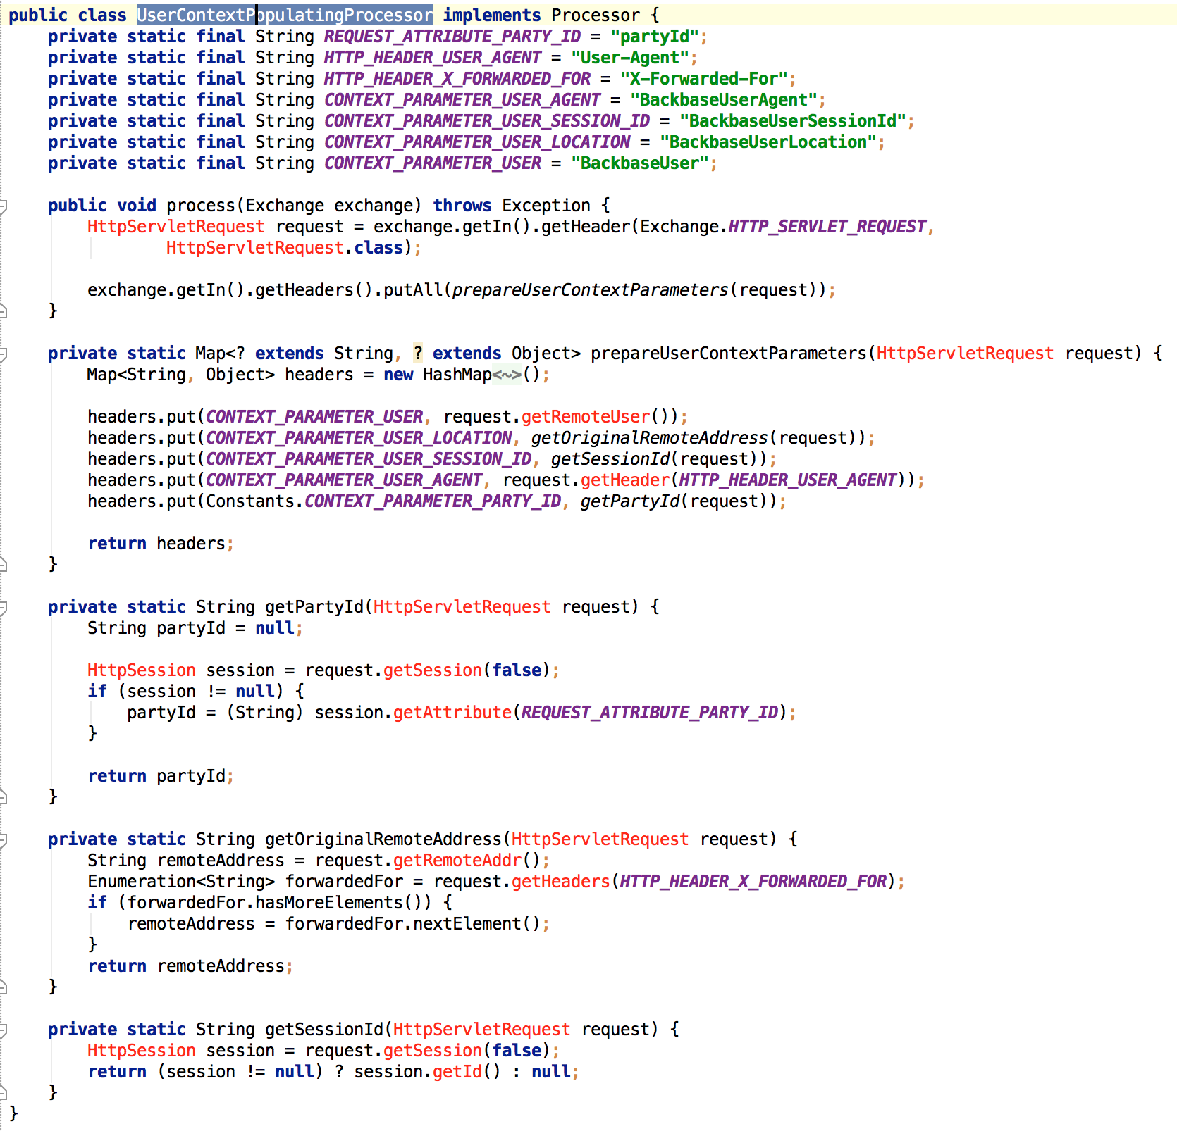
Apache Camel In CXP
User Context Populating Processor
Populates information about logged in user
Notes:
KEY
Context Populating Processor
HOW
Tell participants that the default REST route will always call the Context Populating Processor. It provides useful information for route builders such as user id, location and so on.
TIME
2 min

Slide 36
Apache Camel In CXP
Considerations
CXP REST services are JSON only.
All exceptions are caught and are not forwarded to FE for security reasons
Route Contexts will only be loaded when prefixed with com.backbase.portal.integration.service
Notes:
KEY
Considerations
HOW
Wrap up.
TIME
1 min

Slide 37
Apache Camel In CXP
Non JSON Services
XML
File Upload
File Download
Anything non JSON
Servlet component puts the raw request on the exchange
Must set servletName to Integration Servlet, otherwise Integration servlet cannot find the Servlet component
<from uri="servlet:///sushi/html?matchOnUriPrefix=true&amp;httpBindingRef=#sushiHttpBinding&amp;servletName=Integration Servlet"/>
sushi/html is now mapped on $(contextRoot)/services/sushi/html*
Notes:
KEY
Non-JSON services
HOW
Tell participants that is possible to call non-json services.
TIME
1 min

Slide 38
Environment Preparation
Customizing your CXP project using an IDE

Slide 39
Preparation (1 of 3)
How to guide: Development Environment using IntelliJ
Objectives
Have a typical development environment for CXP applications
Prerequisites
JDK 7+
Maven 3+
Existing CXP project
Outcomes
A ready-to-run environment
Shortcuts to start/stop servers
Configured logging levels
Notes:
KEY
Environment Preparation
HOW
Tell participants that they will configure their CXP development environment. Briefly present the guide and how participants can access it from My Backbase.
TIME
30 min

Slide 40

Preparation

Slide 41
Use Case Information
Training Use Case
Training Widgets
Register
Player
List
Players
Login
2048
Game
List
High
Scores
RESTLET
Integration Services
ROUTE
Training Server
LDAP
Server
REST
endpoints
MOM
(Queues/Topics)
SOAP
services
Notes:
KEY
Exercise Information
HOW
Tell participants that we have prepared a set of integration exercises. These exercises are incremental and are based on the 2048 game use case.
TIME
2 min

Slide 42
Preparation (2 of 3)
Installing the Training Server
Objectives
Install and start the training server
Instructions
https://github.com/Backbase/training-server
Outcomes
An ”up and running” server
Training Widgets
Register
Player
List
Players
Login
2048
Game
List
High
Scores
RESTLET
Integration Services
ROUTE
Training Server
LDAP
Server
REST
endpoints
MOM
(Queues/Topics)
SOAP
services
Notes:
KEY
Preparation
HOW
Tell participants to follow the instructions present in the readme file.
To wrap up, show the training server up and running:
Show, for example, the http://localhost:9999/training-server endpoint with the WSDL and WADL descriptors
Show the hawtio tool http://localhost:9999/hawtio
TIME
15 min

Slide 43
Preparation (3 of 3)
Installing the Training Widgets
Objectives
Install the training widgets into your CXP environment
Instructions
https://github.com/Backbase/training-be-module-01/tree/master/training-collection
Outcomes
A set of widgets will be available in your Enterprise Catalog. They will be useful for testing some Apache Camel routes
Training Widgets
Register
Player
List
Players
Login
2048
Game
List
High
Scores
RESTLET
Integration Services
ROUTE
Training Server
LDAP
Server
REST
endpoints
MOM
(Queues/Topics)
SOAP
services
Notes:
KEY
Preparation
HOW
Tell participants to follow the instructions present in the readme file.
To wrap up, show the list of imported widgets using CXP manager
TIME
15 min

Slide 44
Exercises

Slide 45
Exercise: Setup your first Camel Module
Creating your first integration project
Objectives
Create a simple Camel route
Instructions
Create a new integration module inside the services module
You can use the Spring XML archetype to generate a new project
Go to My Backbase > Docs > Product Documentation > CXP Documentation > Development Guide > Integration Services > How To Create an Integration Service With Camel Spring XML DSL
Check if the newly generated module is a sub-module of the services module
Open the pom.xml file of the services and see the modules section
Create a testing route:
To find one example, see the sub-section Create the Route in Spring XML in My Backbase
Add the newly generated module as a portalserver dependency
Update the dependencies section of webapps/portalserver/pom.xml
Test your new route using a browser or an HTTP client (e.g. Postman)
Notes:
KEY
First Apache Camel route
HOW
TIME
15 min

Slide 46
Exercise: Create a simple Restlet route
Registering a new player
Objectives
Create a route used to register a new player
Instructions
Create a route having the from element pointing to /player/register. Only the method POST should be allowed
Log the incoming message (e.g. input headers and body) using the log component
Forward the POST request to the training server endpoint (http://localhost:9999/training-server/rest/player)
Test the newly created route making a POST call to the /player/register route. You can use an HTTP client like Postman or the Register Player widget
Training Widget
Register
Player
RESTLET
HTTP
Training Server
REST
endpoint
Notes:
KEY
Exercise
HOW
Give a set of hints to participants:
Show the Restlet and HTTP component documentation of Apache Camel. Do not provide the URL of the documentation and ask them to use Google for searching, just to demonstrate how easy is to find Camel docs.
Provide an example of POST call for the training server
POST http://localhost:9999/training-server/rest/player (mime-type: application/json)
{
"username" : "Edsger",
"fullname" : "Edsger Dijkstra",
"password" : "dijkstra123",
"emailAddress" : "dijkstra@gmail.com”,
"birthDay" : "1930-05-11",
"firstName" : "Edsger",
"lastName" : "Dijkstra"
}
Both endpoints (from and to) uses HTTP. They share the same set of headers. In order to avoid conflicts, please, invoke the following command before specifying the to: <removeHeaders pattern="CamelHttp*" excludePattern="CamelHttpMethod"/>
Use placeholders to avoid a hardcoded host and port, use placeholders (e.g. http://{{training.server.host}}:{{training.server.port}}. These placeholders can be defined in the backbase.properties file
TIME
30 min

Slide 47
Exercise: Create a simple Restlet route
Listing players
Objectives
Create a route to list players.
Instructions
Define a route that:
Get a list of players from the training server
Unmarshall the list of players from JSON into a Java object.
Call a processor to sort the list of players by one attribute specified in the query string parameter
Marshall the Java Objects back to JSON
Test the Camel route using an HTTP client (e.g. Postman) and the List Players widget
Training Widget
List
Players
RESTLET
Marshall body
(Java to JSON)
HTTP
Sort players
Training Server
REST
endpoint
Unmarshall body
JSON to Java
Notes:
KEY
Exercise
HOW
Instructions:
The training server has a REST service that allows getting the list of registered users. See the example below:
http://localhost:9999/training-server/rest/player/players
This endpoint returns a JSON representation of a list of users. The problem is that the backend system (training-server) does not provide the sorting functionality. Your task is to create a camel route that allows getting the list of players ordered by the field specified in the query parameter. For example:
GET http://localhost:7777/portalserver/services/rest/player/list?sort=username
Some Hints:
You will use a processor to sort the list of players. This processor will read the body of the input message as a java object. To transform a JSON file to Java you can use the following approach:
Add camel-jackson as a dependency of your service project (POM):
groupId: org.apache.camel
artifactId: camel-jackson
version: 2.13.2
In your route, call the unmarshall function to transform a JSON body to Java after getting the list of players from the training-server
<unmarshal> <json library="Jackson"/> </unmarshal>
The route consumer expects a JSON representation of the list of players. To transform a Java object in the message body to JSON, call the marshall function:
<marshal> <json library="Jackson"/> </marshal>
After getting a list of players and transform the JSON body to java, you need to sort the content. Create a processot with the following method in your route.
@Override
public void process(Exchange exchange) throws Exception {
final HashMap hashMap = exchange.getIn().getBody(HashMap.class);
List players = (List) hashMap.get("players");
final String sort = exchange.getIn().getHeader("sort",String.class);
if(sort != null) {
Collections.sort(players,
new Comparator() {
@Override
public int compare(Object o1, Object o2) {
HashMap player1 = (HashMap) o1;
HashMap player2 = (HashMap) o2;
return player1.get(sort).toString().compareTo(player2.get(sort).toString());
}
});
}
hashMap.put("players", players);
exchange.getOut().setBody(hashMap);
}
Note that your processor must be registered as a Spring bean. For example:
<bean id=“changeOrderProcessor" class=“com.backbase.training.processor.PlayerSortProcessor"/>
TIME
30 mins

Slide 48
Exercise: Create a simple Restlet route
Creating the game state
Objectives
Create a route to create the game state
Instructions
Create a route having the from element pointing to /game/session. Only the method POST should be allowed
Log the incoming message (e.g. input headers and body) using the log component
Forward the POST request to the training server endpoint (http://localhost:9999/training-server/rest/game/session)
Test the newly created route using the 2048 game widget
Training Widget
2048
Game
RESTLET
HTTP
Training Server
REST
endpoint
Notes:
KEY
Exercise
HOW
TIME
20 mins

Slide 49
Exercise: Using queues
Updating the game session
Objectives
Create a route to update the game session
Instructions:
Setup a JMS Connector
Add Camel ActiveMQ component dependencies into your integration project
Configure a Connection Factory using Spring
Define a route that:
Accept PUT requests from the endpoint /game/session/{sessionId}
Send the body of the incoming HTTP message to queue:UpdateGameSession
Test the route using the 2048 game widget
Training Widget
2048
Game
RESTLET
Update game session
JMS
Training Server
Queue:UpdateGame
Session
Notes:
KEY
Exercise
HOW
To speed up the exercise, you can provide the JMS configuration, letting participants concentrating only on the route construction.
TIME
20 mins

Slide 50
Exercise: Using queues
Updating high scores
Objectives
Create a route to update the high score of a player
Instructions:
Define a route that:
Accept PUT requests from the endpoint /player/{username}/highscore
Send the body of the incoming HTTP message to queue:UpdatePlayerHighScore
Test the route using the 2048 Game widget
Training Widget
2048
Game
RESTLET
Update player highscore
JMS
Training Server
Queue:
UpdatePlayerHighScore
Notes:
KEY
Exercise
HOW
TIME
20 mins

Slide 51
Exercise: Using queues
Listening for high score updates
Objectives
Create a route that listen for high score updates
Instructions:
Define a route that will:
Read incoming messages from the topic topic:Player.HighScoreUpdated
Write the body of the incoming message to a new file (e.g. inbox/highscoreupdate)
File
File
Training Server
Topic:
Player.
HighScoreUpdated
JMS
Notes:
KEY
Exercise
HOW
TIME
20 mins

Slide 52
Exercise: Web Services
Calling a SOAP operation
Objectives
Invoke a SOAP operation in a Camel Route
Instructions
Generate JAX WS classes from a WSDL descriptor
http://localhost:9999/training-server/PlayerManager?wsdl
Use Apache CXF wsdl2java maven task
Define JAX-WS bean in backbase-integration-service.xml
Use Spring WS + JaxWsPortProxyFactoryBean
Create a route (e.g. login, getAllPlayers)
Use the Bean component
Marshall output body from POJO to JSON
Test with REST client (such as Postman)
Training Widget
2048
Widget
RESTLET
HTTP
Marshall body
(Java to JSON)
Training Server
SOAP
operation
Notes:
KEY
Exercise
HOW
To speed up the exercise, you can provide the Apache CXF class generator and the Spring Bean configuration, letting participants concentrating on the route construction.
TIME
40 mins

Slide 53
Exercise: Using Camel Cache
Training Widget
Improving the List Players route
List
Players
Objectives
Change the ”List Players” route, by using the cache component.
Instructions
Check if there is a list of players in the cache before getting it from the training server
If the list exists in cache, just return it as is
If not, proceed with all steps, adding a step to save the results in the cache (time to live is 2 minutes)
Test the route using the game widget
For more information see: http://camel.apache.org/cache.html
RESTLET
Get the list of
players from
the cache
Save the list
of players in
the cache
Cache exists
Marshall body
(Java to JSON)
HTTP
Cache does not exist
Sort players
Training Server
Unmarshall body
JSON to Java
REST
endpoint
Notes:
KEY
Exercise
HOW
TIME
40 mins

